Slide 1

M&A – WBD

Slide 2
M&A - What Do Shareholders Want To Know
Acquiring shareholders
Selling shareholders
Strategic rationale
Price
Premium offered
Consideration
Conditions to closing
Potential interloper
Financing of transaction and impact on credit rating
Synergies
Value creation – ROI, NPV of synergies, EPS, impact on share price
Management post deal
Management experience in M&A
Strategic rationale
Price
Premium offered
Consideration
Conditions to closing
Potential interloper

Slide 3
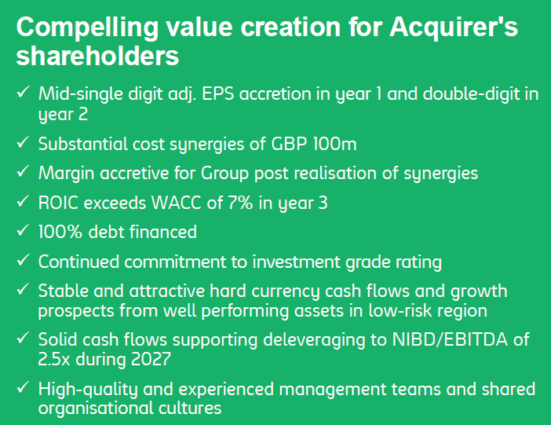
Deal Assessment – The Investor Presentation (An Example)
Important measure for share price (P/E ratio)
6% of target revenues – upper end of comparable transactions
Higher margin = higher valuation
Important measure for investment assessment
ROIC = Return on invested capital
(Target NOPAT + post tax synergies)
Deal EV
Deleveraging in 2 years by 1x EBITDA

Slide 4
Warner Timeline
Dec 2024
In early 2024 WBD decided after due diligence not to make an offer for Paramount Global (predecessor of PSKY)
June 2025
Structure: Streaming & Studios vs Global Networks, most of the debt to sit with Global Networks. Share price initially spiked by 10% but closed 3% down on the day. Complex deal & debt levels
Pre Deal
$10.00
PSKY
all of WBD
Netflix
no networks
Sept 2025
Initial proposal from PSKY: $19.00 (60% cash/40% shares) per share, rejected
$19.00
End of Sept 2025
New proposal from PSKY: $22.00 (66.7% cash/33.3% shares) per share, rejected
$22.00
Mid Oct 2025
New proposal from PSKY: $23.50 (80% cash/20% shares) per share, rejected, press release from WBD: initiate strategic alternatives review
$23.50
End Oct 2026
PSKY wants significant changes to NDA incl. right to require financial institutions to act exclusively for PSKY. Finally sign on 10 Nov 2025
20 Nov 2025
PSKY: $25.50, 85% cash / 15% equity
Netflix: $27, 81% cash / 19% equity
$25.50
$27
4 & 8 Dec 2025
Dec 4: Netflix: $27.75 84% cash / 16% equity
Dec 8: PSKY goes hostile, all cash
$30.00
$27.75
20 Jan 2026
Warner recommends $27.75 all cash bid by Netflix
$27.75
24 Feb 2026
PSKY offers $31 all cash, accepted as superior bid on 26 Feb by Warner, Netflix walks
$31.00

Slide 5
Valuation
Netflix Deal
Fairness Opinion delivered to WBD – analysis by Allen & Company and J.P.Morgan Opinions of Allen & Company and J.P. Morgan in Connection with the Merger Above link can be accessed by all
Streaming & Studios
Selected public comps
$16.09 - $19.99 per share Based on 2026E EBITDA (management projections) 15.0x – 17.0x
Selected transactions
$17.05 - $23.81 per share Based on LTM EBITDA multiples of 17.5x – 25.0x
DCF
Allen & Co: $20.77 - $30.79 per share (WACC 8% - 9.5%, exit multiple 11 – 15x) J.P.Morgan: $20.29 - $30.28 per share (WACC 8.5% - 9.5%, perp. growth 2.5% - 3.5%)
Global Networks
Selected public comps
$1.33 - $3.24 per share Based on 2026E EBITDA (management projections) 4.5x – 5.5x
Selected transactions
$4.63 - $6.86 per share Based on LTM EBITDA multiples of 5.5x – 6.5x
DCF
Allen & Co: $0.72 - $1.65 per share (WACC 6.75% - 8%, exit multiple 4.5 - 5x) J.P.Morgan: $0.72 - $1.58 per share (WACC 7% - 8%, exit multiple 4.5 – 5x)
Combo
Public comps
$17.42 – 23.23
Transactions
$21.68 - $30.67
DCF
Allen & Co: $21.49 - $32.43 J.P.Morgan: $21.01 - $31.86

Slide 6
Regulatory Considerations
 | PSKY & WBD (whole company) | Netflix & WBD (studios + streaming)
Structure | Buys all of WBD, including networks | Buys WBD studios + streaming; networks spun off
Main US concern | Studio/content consolidation but no single dominant streamer | Dominant global streamer; concentration in Subscription Video on Demand and premium content
DOJ stance | Second request issued, then cleared; lower perceived risk | Opened broad antitrust probe; no clearance before Netflix walked
HSR status | Second Request 23 Dec 2025; compliance 9 Feb 2026; HSR waiting period expired 19 Feb 2026 | Never reached HSR review ongoing when deal died
EU / other | Reviews still required but starting concerns seen as lower | Likely in-depth review; behavioural remedies expected
Political angle | Framed as more acceptable politically than Netflix | Higher political scrutiny; Big Tech in streaming narrative. Meeting in White House on 26 Feb. 2026
Current outcome | PSKY past US HSR wait; still needs definitive deal and global approvals | Netflix withdrew after PSKY bid deemed superior

Slide 7
27 Feb: The Press (AI generated)
Financial Times
Paramount has “clinched” Warner Bros after a months‑long campaign to scupper Netflix’s transaction, with its roughly 111 billion dollar, 31‑dollars‑per‑share cash bid for the whole company.​
The paper emphasises that WBD shareholders extracted a higher price, full cash, and broader protections (reverse break fee, coverage of Netflix break fee, ticking fee), framing the outcome as “richly priced but defensible” given PSKY’s need for scale.
Wall Street Journal
Netflix pulled the plug soon after the WBD board judged Paramount’s 31‑dollars‑per‑share offer for the entire group superior to Netflix’s partial asset deal, effectively handing control of Warner’s franchises to the Ellison‑backed group.​
In markets coverage, the Journal highlights that Netflix shares rallied on the decision, casting Netflix as the disciplined bidder and Paramount as the party assuming the leverage and integration risk to create a broader content and streaming platform.
Le Figaro (in English summary)
Describes the Paramount bid as “essential” for PSKY but merely “opportunistic” for Netflix, echoing the view that Paramount could not easily walk away from WBD’s assets without jeopardising its own long‑term competitiveness.
Earlier, the paper had underlined the extraordinary level of debt financing and warned that this raises execution and failure risk, a concern it notes has now been effectively transferred from WBD shareholders to Paramount’s balance sheet.​

