Slide 1
Financing
Instruments

Slide 2
Contents
Types of Debt
Debt Providers / Holders
Equities
Covenants
Collateral
Financing fees
Debt Structure Consideration

Slide 3



Types of Debt: Overview
    Pro-rata
    Generally distributed among commercial banks through loan syndication
Revolving Credit Facility
✓
Term Loan A
✓
Seller
Seller / Vendor Loan
    Institutional
    Generally distributed among institutional investors, arranged by investment banks (underwriters)
Term Loan B/C/D
✓
Senior Notes
✓
In leveraged finance, the expected rating of notes is High Yield (BB+ or below)
Subordinated Notes
✓
Mezzanine
✓
Preferred Shares
Notes:
In leveraged financing, many types of debt instruments are utilized. In every deal, a financial sponsor such as a private equity firm and a strategic buyer negotiate with banks on the best capital structure. Leveraged finance debt can be classified into three types: Pro-rata, Seller, and Institutional.
The Pro-rata portion consists of the revolving credit facility and term loan A
Which are packaged together and distributed among participating banks. For example, if three banks participate in a deal, each bank will own a proportionated amount of a revolving credit facility and term loan A. It is like 40% for a lead bank and 30% for the rest two banks each.
Seller loan is another way of financing to help leveraged buyout. The existing owners of a target company provide loans.
Institutional debt consists of some of the term loans such as term loan B, bonds, mezzanine, and preferred shares.
Those are generally arranged by investment banks and taken by institutional investors. That is the reason why the industry experts call this debt "institutional debt". Banks sometimes take this portion as well.
In leveraged finance, the expected ratings of notes are high-yield. In terms of ratings, BB+ or below because of high leverage.
In this section, we will focus on several types of loans that are frequently used in leveraged finance. Those are revolving credit facility, term loan A, term loan B/C/D, notes, and mezzanine debt.

Slide 4
Types of Debt: Different Characteristics
 | Revolving Credit Facility | Term Loan A | Term Loan B | Senior Notes | Subordinated Notes | Mezzanine
Interest Rate / Coupon | Lowest | Low (SOFR + 200-275bps) | Higher (SOFR + 300-450bps) | Higher | Higher | Highest
Floating / Fixed | Floating |  |  | Fixed
Interest Type | Cash |  |  |  |  | Cash / PIK
Tenor | 3-5 years | 5 years | 7 years | 5-10 years | 5-10 years | 8-12 years
Amortization | None | Straight Line | Minimal | Bullet
Prepayment | Yes |  |  | Generally no
Seniority | Senior |  | Senior / Subordinated | Senior | Subordinated | Subordinated
Security | Secured |  | Secured / Unsecured | Secured / Unsecured | Unsecured | Unsecured
Covenants | Financial Maintenance |  |  | Financial Incurrence
Notes:
This table navigates you through the different characteristics of each debt. The table is somewhat simplified, but it would be better guidance for you. In many cases, senior debt is the cheapest and most available option of all of the financing instruments used to buy a company through a leveraged buyout. It has a lower cost of capital than other tranches of the capital structure because it is senior and, most of the time, secured as 1st lien in the capital structure to receive residual value during a liquidation process of the company.

Slide 5
Debt Providers/Holders
TYPE OF FACILITY
LENDERS
INVESTORS
Banks
Hedge Funds
Insurance / Pensions
CLOs
BDCs
PE Sponsors
Revolving Credit Facility
✓
Term Loan A
✓
✓
Term Loan B/C/D
✓
✓
✓
✓
✓
High Yield Bond
✓
✓
Mezzanine
✓
✓
✓
Preferred Stock
✓
✓
Notes:
This table navigates you through who are the typical lenders and investors in the leveraged finance by facility type
General players in the leveraged buyout market are banks and institutional investors, such as credit fund and an insurance company.
As a notable recent trend, liquidity in the leveraged market has been poured by the resurgence of the CLO market. A term CLO stands for Collateralized Loan Obligation and is a special purpose vehicle set up to manage a pool of loans. Due to the increased presence of CLOs in the market, banks are able to syndicate deals widely and hold less on their balance sheets, enabling a greater volume of deals to be done.
The growth in private lending and business development companies (BDCs) also added momentum to this trend by providing dedicated capital for other junior capital solutions, such as second lien loans. BDCs are publicly-traded companies that invest in and finance SMBs. BDCs are playing an essential role in giving retail investors access to private investment opportunities.
Also, recently some private equity firms take term loan B/C/D or high yield bonds by using their credit investment fund, which expands its ability to take risks because they do not need to rely on banks distribution network and third party institutional investors appetite.

Slide 6
Unitranche Financing
Merges senior and junior/subordinated debt into one tranche
SEPARATE LENDERS
DIRECT LENDER
Senior secured debt
First Out Investors
SENIOR
Senior unsecured debt
UNITRANCHE STRUCTURE
Last Out Investors
JUNIOR
Subordinated debt
Super Senior Revolver
BANK PROVIDED
Notes:
One last significant debt product is unitranche. Basically, private lenders looking for return in the market looked at all these trends (cov-lite, sponsors looking for speed and flexibility) and came up with an idea. They created a financing option called 1) unitranche, 2,3,4,5) which merges senior and junior/subordinated debt provided by multiple providers into one tranche arranged entirely by one fund.
There are roughly 30 unitranche 6) direct lenders, invested in by hedge funds, private debt funds, private equity funds, etc.
They offer one blended rate to the issuer for all the tranches, which are then carved out 7)between first in (priority) and 8)last out (second priority).
Unitranche loans do not amortize generally and offer the same features of the cov-lite loans.
Rates between 6 and 8%Pricing is higher than would be achieved via separate tranches but execution risk is much lower.
9) Revolvers are the tricky part of these loans and can still be provided by traditional banks. They are generally arranged as Super Senior to all other borrowings.

Slide 7

Equities
Hypothetical Capital Structure of Leveraged Buyout
Management Equity works…
 | $ in millions | % of Capitalization | EBITDA Multiple
Revolving Credit Facility - 5 years | 0 | 0.0% | 0.0x
Term Loan A - 6 years | 360 | 36.7% | 3.0x
Term Loan B - 8 years | 240 | 24.5% | 2.0x
TOTAL SENIOR SECURED DEBT | 600 | 61.2% | 5.0x
Subordinated Notes due 20XX | 180 | 18.4% | 1.5x
TOTAL DEBT | 780 | 79.6% | 6.5x
Management Rollover Equity | 10 | 1.0%
Sponsor Equity | 190 | 19.4%
TOTAL EQUITY | 200 | 20.4%
TOTAL CAPITALIZATION | 980 | 100.0%
EBITDA | 120
1
To help reduce cash investment for financial sponsors and
To align incentives between financial sponsors and management of the target
2
Management had at least 5% of the seller company’s equity
Management decided to keep their stake in the transaction
Notes:
In this section, we provide you with some practical insights relating to equity arrangement in a leveraged buyout. Equity package is as important as debt structure because it affects the probability of success of the deal. Acquirers ponder how much equity should be injected and also its components. The typical equity amount is 20 to 30% of the Pro-forma enterprise value of the target company. 1) When deciding the amount, you need to carefully consider the management portion that management of the target company will own post-transaction. 2) Management involvement is key to the success of a private equity leveraged buyout transaction, so a PE fund will invite the target company’s management team to roll a portion of their equity stake into the post-closing company. It means “skin in the game”.
Management equity often referred to as rollover equity, is provided as an incentive to management, as they can get an opportunity to achieve additional economic compensation by increasing stock values. Also, management equity may be attractive to the sellers from a tax perspective. The scale and implementation of management equity may vary from transaction to transaction, depending on the company valuation, capabilities of seller's management team, and so on.
3)In the example here, we are assuming a 5% rollover. This means that the management team owns at least 5% of the existing equity and agrees to keep 5% invested alongside the sponsor.

Slide 8


Covenants
TYPES OF COVENANTS
POPULAR CLAUSES
Filing quarterly and annual financial statements
Carrying insurance for the issuer’s assets
Obligating the issuer to promise to repay the principal of a loan at maturity
Affirmative Covenants
Promises by the borrower
Restricting asset disposals, distributions to shareholders,
or engagement in (risky) investments
NOT pay dividends beyond specified amount
NOT issue additional debt without lenders/bond holder’s permit
Negative Covenants
Prohibitions on the borrower
The borrower must maintain financial metrics such as leverage, interest coverage, and capital expenditure (Debt/EBITDA ratio of less than 5.0x)
The ratio will be tested for compliance on a quarterly basis
Financial Covenants
Promises by
the borrower
Maintenance
The borrower must not incur new / additional debt unless the borrower’s Debt /EBITDA ratio is less than 5.0x after giving pro forma treatment for the new debt
Incurrence
Notes:
Leveraged finance entails covenants to protect lenders and bondholders by restricting how borrowers can operate and carry themselves financially. The size of covenants increases as lenders see more risks in borrowers or capital structure of deals.
Covenants typically consist of three primary types: 1)Affirmative Covenants, 2)Negative Covenants, and 3)Financial Covenants.
4)Affirmative covenants stipulate what actions borrowers must take to be in compliance with the debt. These covenants usually require a borrower to pay lenders loan interest and fees, provide audited financial statements, pay taxes, and so on.
5) Negative covenants limit borrowers’ activities, and thus these covenants are carefully structured and customized to each borrower’s specific situation. Prevalent negative covenants include limiting new acquisitions and investments, debt issuance, and so on. In some cases, borrowers are allowed to invest within a set range agreed with lenders, for example, a certain percent of free cash flow or net income.
6)Financial covenants require borrowers to maintain healthy financial performance. Financial covenants consist of two types: maintenance and incurrence. Under maintenance covenants, lenders usually set a minimum cash flow coverage and leverage ratio. 7)On the other hand, incurrence covenants force borrowers to test Pro-forma financials before taking actions, such as investments and acquisitions.

Slide 9
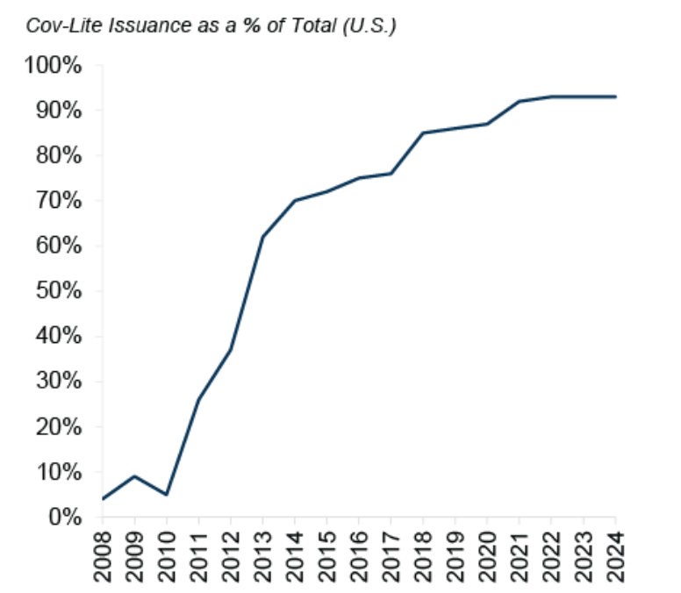



Covenant Lite (Cov-lite)
What is Covenants Lite Debt?
Any facilities that do not require borrowers to comply with financial maintenance covenants
No or fewer financial covenants means less investor protections
Over 90% of leveraged loans are covenant lite
Those loans help borrower companies to avoid bankruptcy in times of financial stress
Notes:
In the leveraged finance market, 1)covenants light (aka Cov-lite) loan or issuance has been growing
2)Covenants-light types of debt have no/fewer investor protections. 3)Those loans make it easier for companies to avoid bankruptcy in times of financial stress but increase the risk for lenders who are less protected by strong contractual agreements.
4)Before the global financial crisis, over 80% of the leveraged loans were considered covenant-heavy. However, in the current market, over 80% of loans lack decent covenants because the market has shifted to more relaxing restrictions to keep the borrowers arrive in the short term.

Slide 10
Collateral
Collateral is an asset or property that an individual or entity offers to lenders as security for a loan e.g.
Typical Collateral and Seniority of Debt Instruments
Revolving Credit Facility
Secured with 1st Lien Usually secured with a first priority pledge of all assets
Term Loan A
Term Loan B/C/D
Generally unsecured
but sometimes secured
with 2nd lien
Blanket Lien
Property
Senior Notes
Inventory
Subordinated Notes
Generally unsecured
Accounts Receivable
Mezzanine
Notes:
In leveraged buyout deals, banks and bondholders usually ask for collaterals to sponsored companies to hedge credit risks associated with the deal. What is collateral?
Collateral is an asset or property that an individual or entity offers to lenders as security for a loan. Collateral is acting as a protection against a loss in a bankruptcy from the lender’s perspective and help borrowers to get financed.
Collaterals vary a lot from properties to accounts receivables, but in the leveraged loan market, collateral usually includes all the tangible and intangible assets of the borrower with a lien. A lien is a legal right acquired in one's property by a creditor. A lien generally stays in effect until the underlying obligation to the creditor is satisfied. If the underlying obligation is not satisfied, the creditor may be able to take possession of the property involved.
Because of the higher risk of default, in most of the cases, leveraged loans, specifically for a revolving credit facility and term loan A are collateralized with 1st lien. There are sometimes 2nd lien loans, which sit below a 1st lien loan in the capital structure and is secured only if there is asset value left after securing 1st lien loans in a bankruptcy

Slide 11
Financing Fees
Fees for Loans
Upfront Fee | Fees payed to loan-providing banks
Administrative Agent Fee | Fees paid to administer banks as consideration for arranging loans
Commitment Fee (Ticking Fee) | Fees paid to lenders on undrawn portion of revolving credit facilities
Facility Fee | Fees paid on a facility’s entire committed amount, regardless of usage
Prepayment Fee | Fees associated with prepayment of generally fixed interest loans as a penalty
Financing Fees = Initial Principal Amount x Financing Fees %
Financing Fees do not include interest or coupons
For revolving credit facilities, a commitment fee is used
Fees for Bonds
Registration Fee | Fees paid for certain regulatory authorizations (e.g. SEC in bond issuance in the US)
Underwriting Fee | Fees paid to underwriters of bonds (investment banks)
Notes:
There are several types of fees around financing. In this chapter, we will cover typical financing-related fees. Most often, fees are paid on a lender’s final allocation. Therefore, loan arranger banks, called Lead Arranger or Bookrunner, take a larger amount of fees.
For bank loans, there is interest rate that is charged annually or bi-annually on the amount of principal. In addition to interest rates, there are several one-time costs that borrowers are obliged to pay. First, upfront fee is a fee paid to all bank lenders generally in exchange for arrangement of loans. Arrangement fee is also paid in exchange for arrangement of loans, but only paid to arrangement banks that led a transaction. Commitment fee is a fee for banks’ commitment to lend money whenever borrowers need financing. Facility fee is another type of commitment fee paid on a facility’s entire commitment amount, regardless of usage. Lastly, prepayment fee is associated with prepayment as a penalty.
For bonds, registration fees are paid to a certain regulatory authority to register notes. Also, investment banks that underwrite bonds will be paid underwriting fees.
Calculation of financing-related fees is usually "fee percent x the initial principal amount of loans or bonds". For example, if a private equity fund agreed on a capital structure like this. Revolving credit facility of $150mm, term loan A of $360mm, term loan B of $240mm, and subordinated notes of $180m. In this case, the total financing fee will be $9.6m. For revolving credit facilities, on the capital structure, it is given as undrawn basis so the amount is 0. But, in a calculation of financing fees, its commitment amount is multiplied by the associated financing costs.

Slide 12







Debt Structure Consideration
FINANCING COST
INVESTOR RELATIONSHIP
CERTAINTY OF FINANCING
REFINANCING
CASH FLOW IMPACT
COVENANTS
Notes:
The debt structure is decided, considering multiple elements. Key elements are 1)Financing Cost, 2)Relationship, 3)Certainty of Financing, 4)Refinance Opportunities, 5)Cashflow Impact, and 6)Covenants. The optimal capital structure may vary deal by deal, taking into account these components. For financing costs, generally, bank loans are cheaper, but the cash flow impact is large because of straight amortization. On the other hand, subordinated bond typically has less restrictive covenants or limitations and coupon-only payments with pay down due upon maturity of the debt. Thus, it is not as painful as bank loans for borrowers, but the certainty of financing is highly dependent on the capital market situation, and refinance is costly because most of the bonds are non-callable. Therefore, in leveraged finance, an acquirer will analyze each element and figure out what is positive or negative with a select capital structure.

